Slide 1
LUCKY KÁVÉZÓ

Slide 2
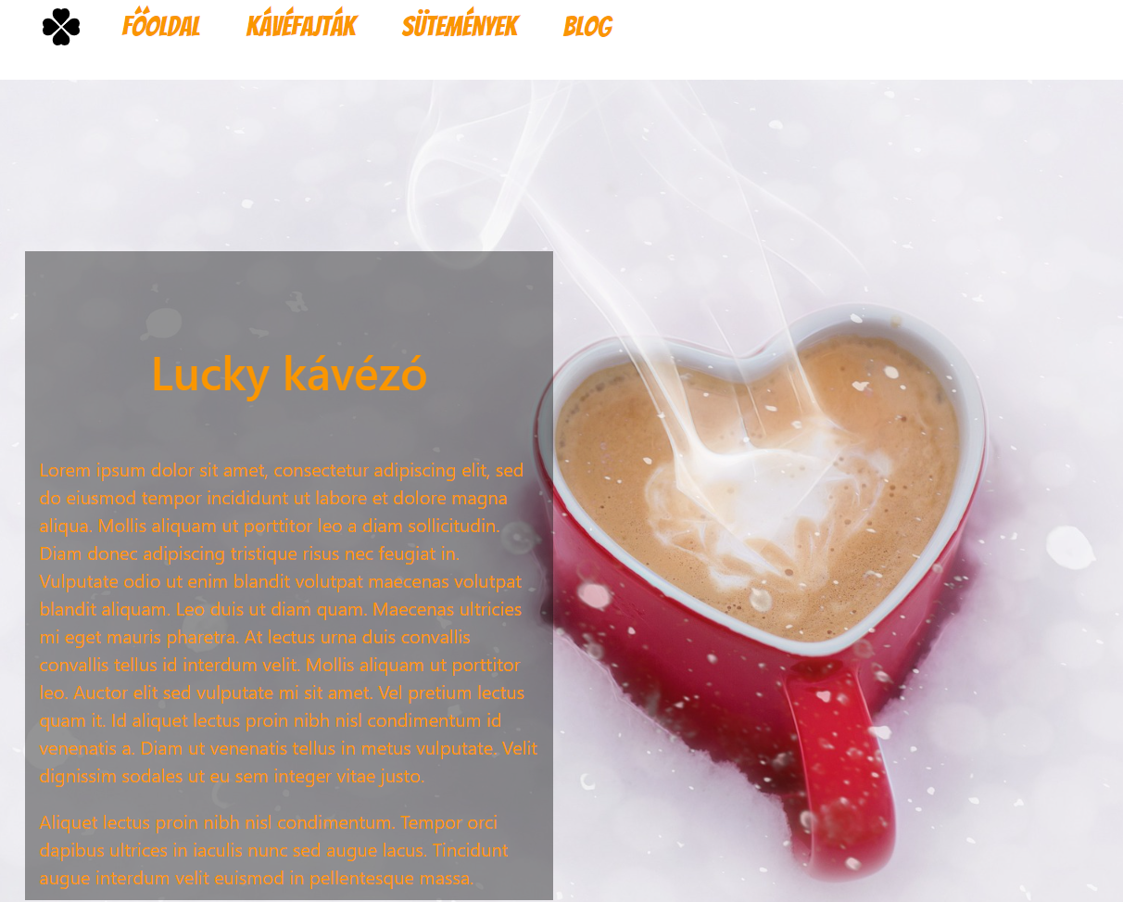
THE MAIN PAGE
The main page of the coffee shop
was the easiest to make.
It has a simple code,just refrences
to the other pages .
On the left there is a Latin welcome text.

Slide 3
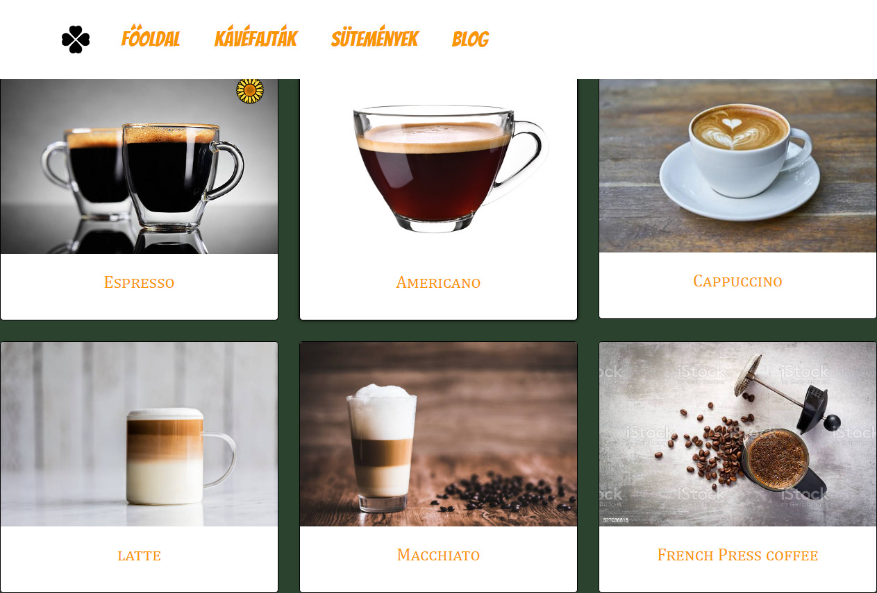
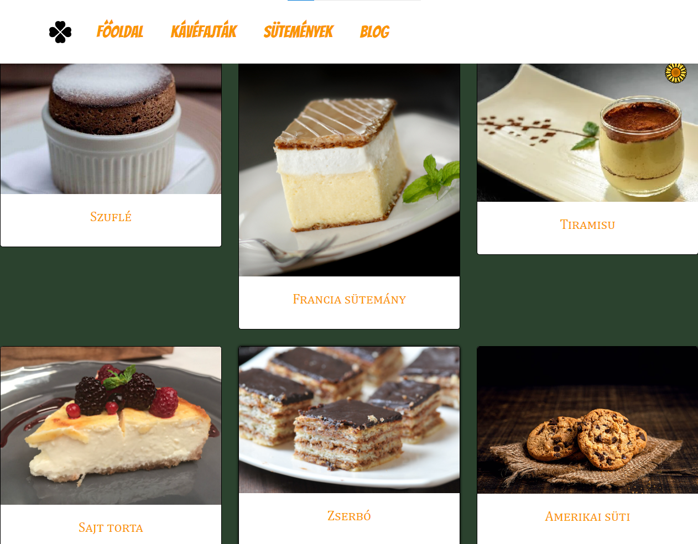
THE COFFEE AND CAKES

Slide 4
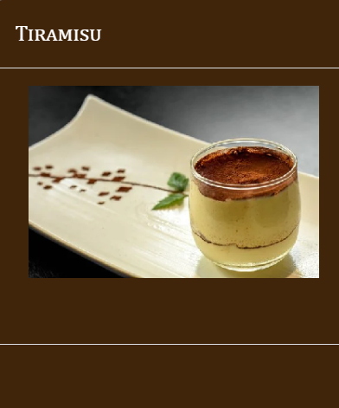
ABOUT THESE PAGES
These were the most problematic pages out of all of them.
The styling was made with a css.stylesheet
And the funcionality was made with a bootstrap injection
The bootstrap was malfuncioning a lot of times,but in the end we made it work

Slide 5
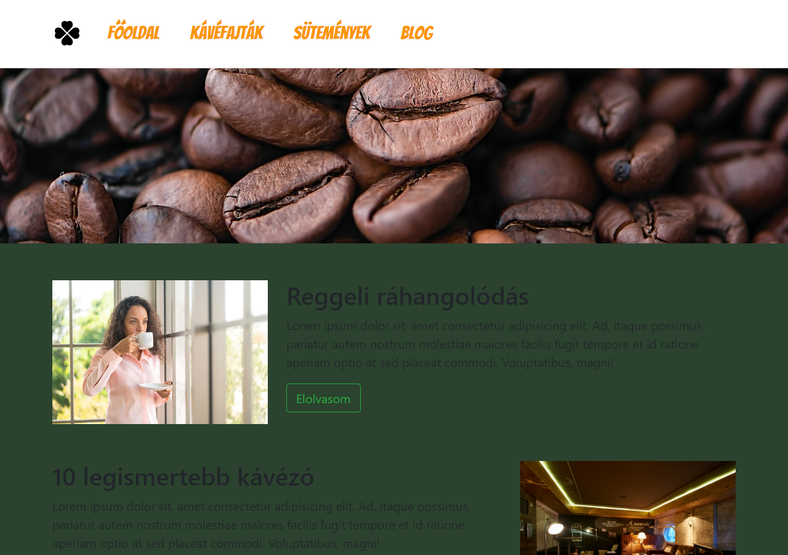
BLOG PAGE
This page is a newsletter page about coffee’s, coffee shops,
and relaxation tips.
This was fairly easy to make.

Slide 6
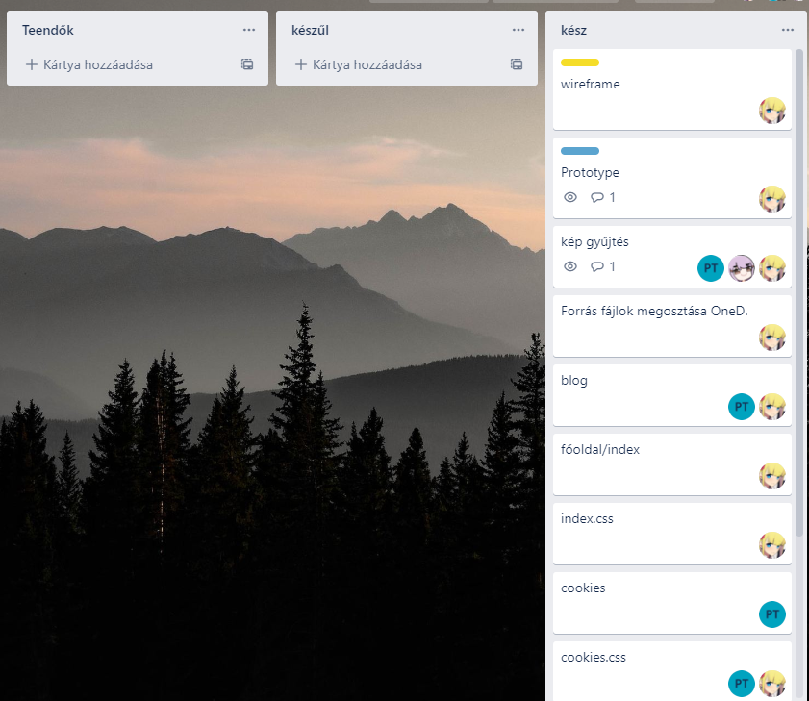
ABOUT THE GROUP WORK
This was our timetable,on this project there was 3 people on the job
Takács Péter-leader
Soponyai Áron-main programer
Roben Rómeó-main github user and second programmer

Slide 7
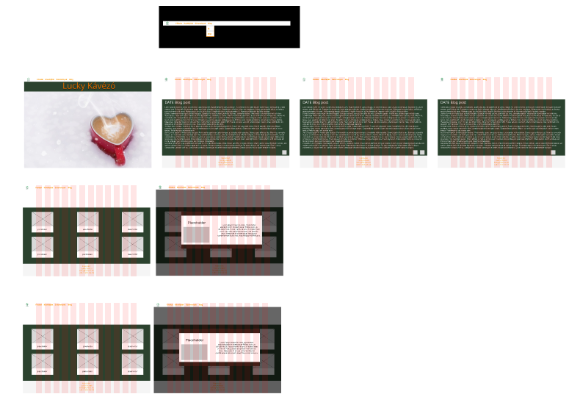
THE SKETCH
These are the sketches of our work.It was made on FIGMA

Slide 8
AND THE MAIN ATTRACTION
Here’s the link to our webpage so we can check it out live:
https://robenromeo.github.io/kavezo_uwu/

